Slide 1
Análisis del Cableado Estructurado en un Centro de Datos

Slide 2
¿Quienes Somos?

Slide 3
Soluciones

Slide 4
AGENDA

Slide 7
The State of the Data Center

Slide 8
Datacenter Lifecycle

Slide 9
Data Center Project Lifecycle

Slide 10
Picking a Starting Point

Slide 11
2. Installation and Validation Cable and Fiber Testing

Slide 12
Agenda – Fiber/Copper Infrastructure Testing

Slide 13
Today’s Datacenter

Slide 14
Networks for a Virtualized Datacenter

Slide 15
Networks for a Virtualized Datacenter

Slide 16
Networks for a Virtualized Datacenter

Slide 17
Networks for a Virtualized Datacenter

Slide 18
Copper Cabling in the Data Center

Slide 19
Networks for a Virtualized Datacenter

Slide 20
Example: Copper Applications

Slide 21
TIA Categories for UTP components and links

Slide 22
Standards also provide specifications for test methods and accuracy of field test equipment

Slide 23
Plugs and standards

Slide 24
Alien Crosstalk (AxTalk) testing:

Slide 25
How is it measured?

Slide 26
Networks for a Virtualized Datacenter

Slide 27
Fiber Optic Cabling in the Data Center

Slide 28
IEEE 802.3ba 40/100G Ethernet

Slide 29
OM4 goes farther! Do you need it?

Slide 30
Data Center Evolution

Slide 31
Verifying Continuity, Polarity, and Insertion Loss for Datacenter links

Slide 32
Verification -Inspecting and Cleaning

Slide 33
Verification with a VFL

Slide 34
What is needed …

Slide 35
Introducing MultiFiber™ Pro

Slide 36
Prepare the meter for testing

Slide 37
Certifying Data Center Fiber Links and Channels

Slide 38
Tier 1 (Basic Certification )

Slide 39
Certifying Data Center Fiber Cabling with an OTDR –Tier 2

Slide 40
How does an OTDR work?

Slide 41
Simple OTDR Trace

Slide 42
Datacenter OTDR requirement #1

Slide 43
Datacenter OTDR requirement #2

Slide 44
Datacenter OTDR requirement #3

Slide 45
Datacenter OTDR requirement #4

Slide 46
Finding Faults in the Datacenter

Slide 47
Tools To Measure Reflectance

Slide 48
Testing With An Optical Fiber Troubleshooter

Slide 49
Comparación de Rendimiento

Slide 50
Poor ACR (and NEXT problems)can lead to FCS and CRC errors and – Retransmissions!

Slide 51
Near End Crosstalk (NEXT)

Slide 52
También tenemos lomos….. Perdida de retorno

Slide 53
Combinando 2 efectos: atenuación y NEXT: S/N = ACR

Slide 54
El concepto de “power sum”

Slide 56
ANSI/TIA requirements

Slide 57
Poor ACR (and NEXT problems)can lead to FCS and CRC errors and – Retransmissions!

Slide 58
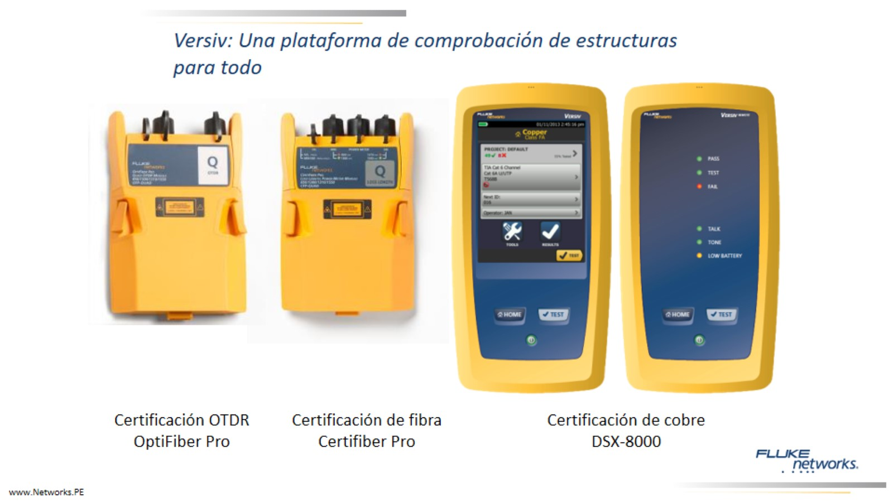
Versiv: Una plataforma de comprobación de estructuras para todo

Slide 59
LinkWare Live supports DSX-8000

Slide 61
Fallo de NEXT #1

Slide 62
Fallo de Pérdida de Retorno #1

Slide 64
Alien Crosstalk

Slide 65
¿Qué es Alien Crosstalk?

Slide 66
Ready for Today’s and Tomorrow’s Requirements

Slide 67
http://www.networks.pe/cctt

Slide 68
https://www.facebook.com/Networks.Peru

Slide 70
Gracias por su tiempo

